Slide 1
The Climate Action Challenge in Ireland
Laura Kevany
Dublin Economic Workshop
September 2021

Slide 2
Objective of today’s presentation
To help you understand the sources of greenhouse gas emissions in Ireland and what drives them
To give you an understanding of the scale of the climate challenge that Ireland is facing
To outline and discuss the role of the Department of Public Expenditure and Reform

Slide 3
Ireland’s Climate Action Targets
Ireland has domestic and EU 2030 targets in relation to greenhouse gas emission reductions:
The Government has set an ambitious legally binding target of a 51% reduction in total greenhouse gas emissions by 2030 and net zero greenhouse gas emissions by 2050.
EU target currently a 30% reduction in national emissions (relative to 2005) by 2030. Proposal to increase to 42%.
Not like for like targets:
Domestic target is economy wide
EU target covers emissions in the non-traded sectors (non-ETS) i.e. agriculture, transport, buildings for the most part.

Slide 4
Sources of Irish Greenhouse Gas Emissions and Progress on Reducing Emissions
In 2019 Ireland’s total national greenhouse gas emissions were estimated to be 59.78 million tonnes of carbon dioxide equivalent (Mt CO2 eq). Emissions decline of 4.4%.
Over 2005 – 2018, more the 60% of the reduction in greenhouse gas emissions achieved has been attributable to the “energy industries” sector.
In 2019, emissions from electricity generation have decreased by 11% for the second year in a row, due to large decreases in the use of coal and peat in Ireland’s power plants.
Provisional estimates for 2020 suggesting a further decline of 5.9%. However, unlikely to result in us reaching 2020 targets.
Still 4th highest per capita emissions in the EU.

Slide 5
Progress on Ireland’s 2020 targets
Ireland has been exceeding our EU annual greenhouse gas emissions limits since 2016.

Slide 6
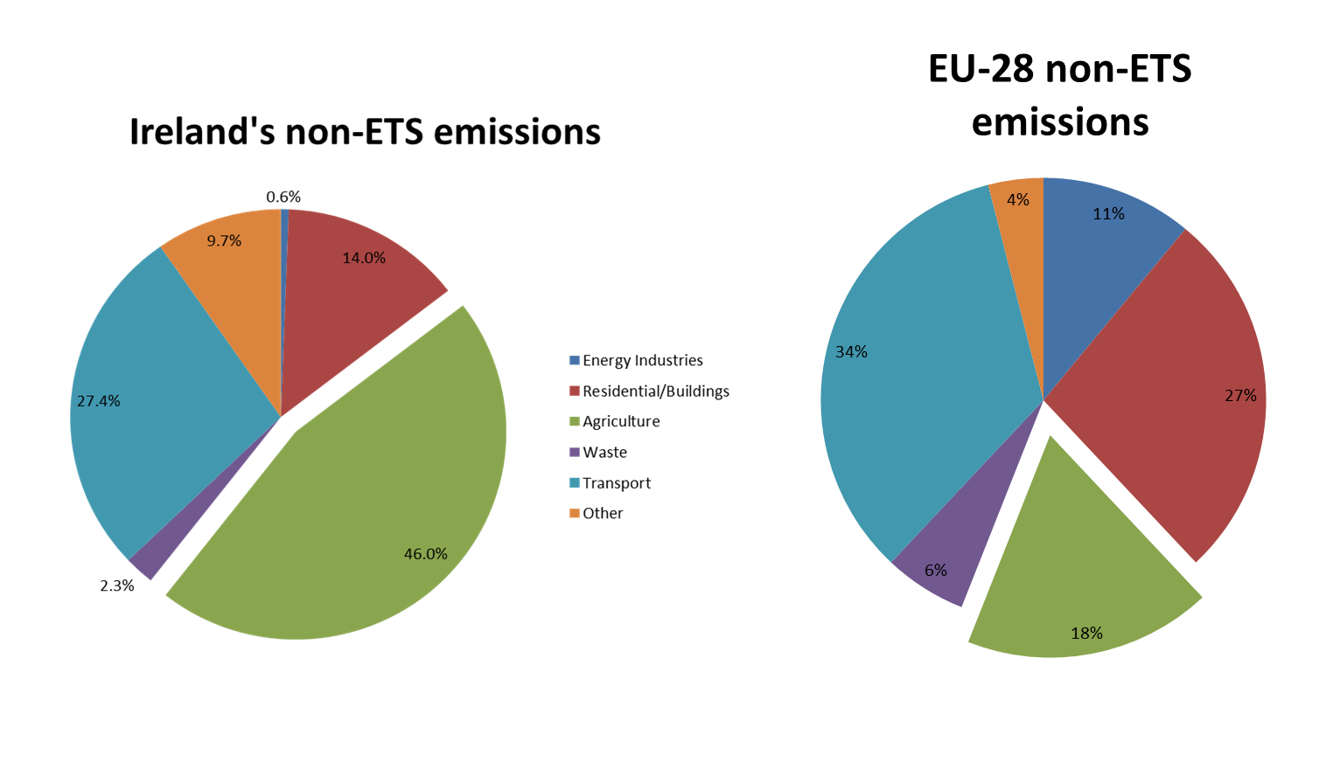
Why has Progress Been So Poor?
Ireland has a uniquely challenging non-ETS emissions profile

Slide 7
Agriculture
Transport
Emissions from the sector have increased by 9.5% since 1990
Attributable to cattle numbers and fertiliser usage
Structure of the sector is almost entirely herd based –so limited abatement potential
Nitrogen fertiliser use is projected to increase (absent intervention), as is output from the dairy sector
Animal numbers in the beef sector are slowly declining but as the dairy sector is more emissions intensive than the beef sector, continuing increases in dairy production risk continuing increases in total emissions from the sector.
The transport sector has seen the largest growth in emissions since 1990, with emissions increasing by 137% to 2019.
95% of emissions in the transport sector are attributable to road transport.
Oil is the dominant energy source in the transport sector, comprising 99% of final energy use in the sector.
Built Environment (Homes, Public & Commercial Buildings)
Irish homes are considerably larger than the EU average, are typically heated by more carbon intensive fuels and much of the older building stock exhibits relatively poor energy performance.

Slide 8
Where Next?

Slide 9
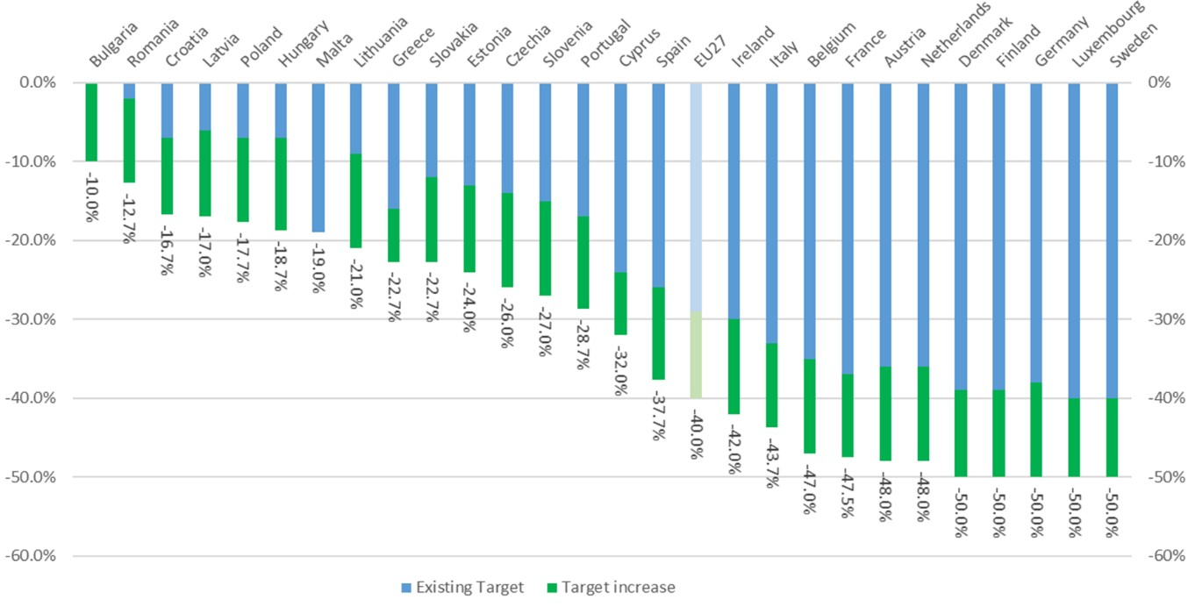
Fit for 55- Increasing European Ambition
Published 14 July
Aims for “at least” 55% reduction in greenhouse gas emissions by 2030 (relative to 1990 levels); climate neutral continent by 2050
13 Legislative proposals: 8 revisions to existing instruments, 5 new instruments

Slide 10
Climate Action and Low Carbon Development (Amendment) Act 2021
Climate Targets - Commits to a climate resilient and climate neutral economy by 2050
Climate Change Advisory Council - Strengthens role of CCAC
Carbon Budgets - CCAC to propose successive five year “carbon budgets”. Government must accept or accept with amendments. Oireachtas approval required.
Sectoral Emission Ceilings - Carbon budgets to be translated into sectoral emissions ceilings for relevant Ministers by the M/ECC
Annual Climate Action Plans - Set out specific actions and potential policies that M/ECC considers may be required on a sector by sector basis to meet carbon budgets.

Slide 11
Climate Action Plan 2019
The CAP of 2019 was designed to achieve average annual emissions reductions of 3 – 3.5% a year (25% cumulatively by 2030)
This was to be achieved via:
45% - 50% decrease in Transport Emissions
40% - 45% decrease in Buildings Emissions
10% - 15% decrease in Agricultural Emissions
70% Renewable Electricity
€80 a tonne Carbon Tax
In practice this means:
936,000 Electric Vehicles by 2030
500,000 Deep Energy Efficiency Renovations
400,000 Heat Pumps Installed in Existing Dwellings
Revised Climate Action Plan development currently under way- Need policies and measures to fill the gap to 7%.

Slide 13
DPER’s Role
Mission Statement is “delivering well-managed and well-targeted public spending”
Has a general responsibility to ensure policies are cost effective and distributionally fair
Given ambition of targets, how to make decisions on the allocation of scarce economic resources

Slide 14
Aligning Public Investment with Climate Ambition
National Development Plan review will set out capital spending levels and priorities for the next decade.
The investments planned will provide for the decarbonisation of society, while meeting the needs of a population that will be 1 million larger by 2040.
Ex-Ante Assessment of Investment
Ex-Ante Impact Assessments will be required for measures proposed in the National Development Plan.
Quantitative assessment of the net impact on greenhouse gas emissions the proposal will have.
These emissions are priced based on the estimated marginal cost society will incur to reach specific climate targets- what it will likely cost society to reach our climate targets by adopting an offsetting measure that will reduce emissions.
Critical that the Public Spending Code provide a realistic assessment of the likely climate and environmental consequences of Government investment decisions so as to allow Government to take fully informed decisions.

Slide 15
Public Spending Code
Shadow Price of Carbon
In 2019, the Department of Public Expenditure & Reform tripled the price of carbon that is applied in the Code.
Based on the estimated costs associated with achieving a 30% reduction in greenhouse gas emissions by 2030.
Now Ireland intends to cut greenhouse gas emissions by 51% by 2030 and to reach a climate neutral economy by 2050, with any remaining emissions balanced by the removal of greenhouse gas emissions from the atmosphere.
Things to consider..
How does the appraisal system need to change?
How should we value emissions in 2050?
The marginal value for a tonne of greenhouse gas emissions in 2050 should be based on the estimated cost of eliminating the last tonne of carbon or, more likely, the estimated cost of a measure that will sequester or capture this carbon. This cost is, to put it mildly, subject to considerable uncertainty but is likely to be considerably higher than the figure in use today.
No obvious framework to follow.

Slide 16
DPER’s Programme of works
Updating the Code
DPER have a programme of works in pipeline to ensure the PSC reflects the increased ambition.
Priority will be on significantly increasing the cost associated with any release of additional greenhouse gases into the atmosphere. Is a marginal abatement cost still the optimal choice? Social cost?
DPER/OECD work will be progressed on a new model for assessing the emissions impact of infrastructure investment. This is to ensure that the full range of potential consequences for this type of investment are captured and valued appropriately.
How Government should consider and appraise investments that may be vulnerable to the impacts of climate change.
Work will be progressed on understanding the role of an instrument like the Code, in a scenario where net zero greenhouse emissions must be achieved by 2050.

Slide 17
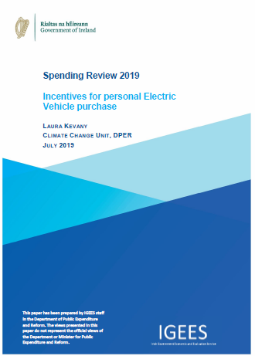
Ex-post analysis of spending programmes
In addition to these high level programme metrics, the Irish Government will continue a programme that undertakes regular, in-depth assessments of specific spending programmes, including climate related expenditure programmes.
Focus on efficiency and effectiveness of spend.
For example, in 2019 the Department of Public Expenditure and Reform undertook and published a review of all the Government incentives available to support the take-up of electric vehicles.

Slide 18
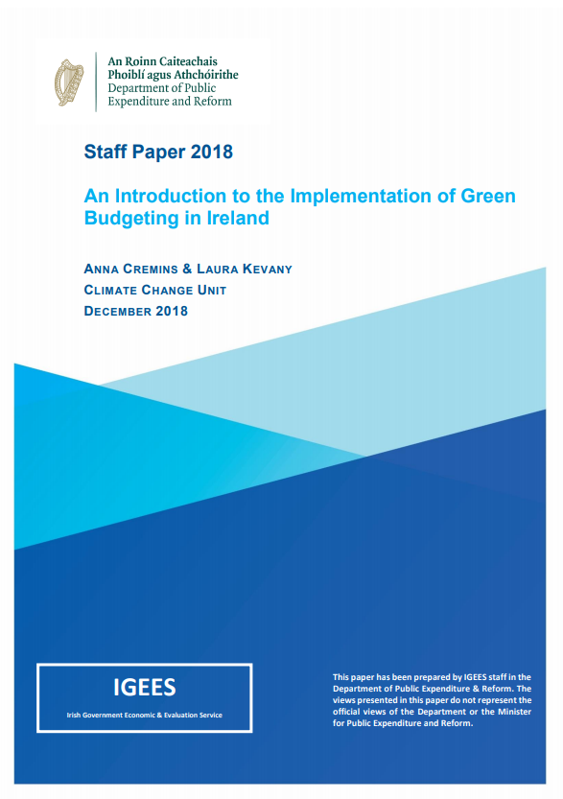
Green Budgeting
Identifying and “tagging” all Exchequer climate-related expenditure became a necessary first step in the Revised Estimates Volume for the Public Service
Ensuring budgetary processes conducive to effective decision making

Slide 19
Direct Exchequer Climate-related Expenditure
€1.61 billion in 2019
€2.03 billion in 2020
23%
  Includes only those expenditure items which we believe directly contribute to emissions reductions
  In reality, there is significant other Govt expenditure on climate matters:
    Support for innovation, upgrades to schools, school transport, water investment
  These were reflected as narrative in the 2018 report
  Next step will be identifying climate harmful expenditure- expanding on work of the CSO
  Develop impact metrics which are more closely linked to achieving Ireland’s climate and environmental targets
€2.91 billion in 2021
44%

Slide 20
Taking Stock
Climate change poses an existential risk to the economic security of the State on the scale of Brexit, just over a longer timeframe
There’s no one “silver bullet” solution
We need taxation, regulation, public expenditure and behavioural change
The scale and nature of the challenge to meet Irelands ambitious greenhouse gas emissions targets and lay the foundations for achieving carbon neutral economy by 2050 cannot be overstated
Our climate performance has to go from negligible reductions of 0.1% to reach an average of 7% per annum
This will not be achieved without a complete refocus of societal priorities, coupled with adequate State investment.
In DPER we will be working to ensure the frameworks for allocating Government resources remain fit for purpose and align with the growing ambition on climate action.

Slide 21
Thank you

